Slide 1
TRAFFIC ANALYSIS AND PREDICTION premier project by Team SciPy HDSC SUMMER COHORT 2022

Slide 2


Active Team members
Presenters
Joshua Obikunle. Bertram Okonkwo.
Chisom Promise – Project Lead
Pearse Jim - Assistant Project Lead
Victoria Udoh - Query Analyst
Pragati Thakur | Djardo Isaac | Lakshay Arora
Gozie Ibekwe | Joshua Obikunle | Bissalla Daniel
Babatunde Raji | Oguamanam Chinyere P. | Emekobong Udoh
Zainab Mohammed | Bernard Boateng | Odion Sonny-Egbeahie
Fidel Imasuen | Subair Hussein K | Omotayo Waheed
Bertram Okonkwo | Samuel Nnamani | Kevin Outta

Slide 3
Problem Statement
Traffic congestion is rising in cities around the world. Contributing factors include expanding urban populations, aging infrastructure, inefficient and uncoordinated traffic signal timing and a lack of real-time data. Given the physical and financial limitations around building additional roads, cities must use new strategies and technologies to improve traffic conditions.
In this project, I will analyze the provided dataset on Kaggle. The provided dataset includes hourly traffic data on four different junctions in a particular city.

Slide 4
AIMS AND OBJECTIVES
The aim of this project is to derive insights from this analysis and then build a model that can be used to predict traffic at particular times at the different junctions in the city.

Slide 5
Dataset Description
The Dataset was gotten from Kaggle and this dataset contains 48.1k (48120) observations of the number of vehicles each hour in four different junctions: 1) DateTime 2) Juction 3) Vehicles 4) ID

Slide 6
Workflow
Data Wrangling
Data Exploration and Visualization
Feature Engineering
Model Training and Evaluation
Model Deployment

Slide 7
Data Wrangling
The following steps were taken in the data wrangling process.
Converting the datetime column to date time object and extracting different time frames
Different visualizations were created for each time frame.

Slide 8
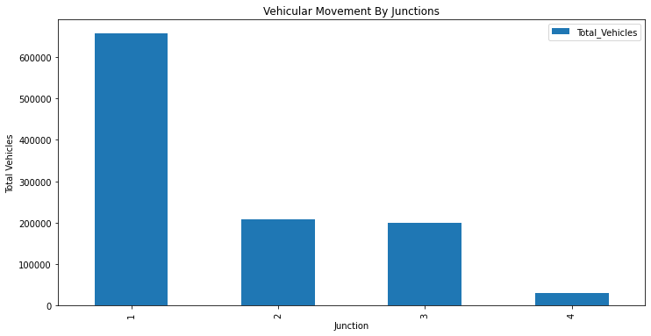
Data Visualization
Total Vehicular Movement for each Junctions
It can be seen that Junction 1 has the highest cumulative vehicular movement over the date under consideration

Slide 9
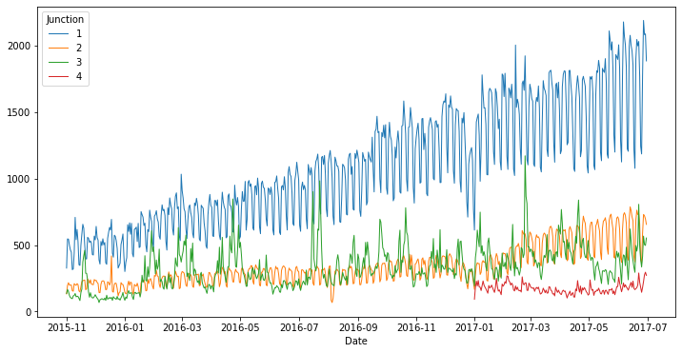
Data Visualization
Vehicular movement volume per duration under review
Junction 1 has constant growing rate of vehicular movement

Slide 10
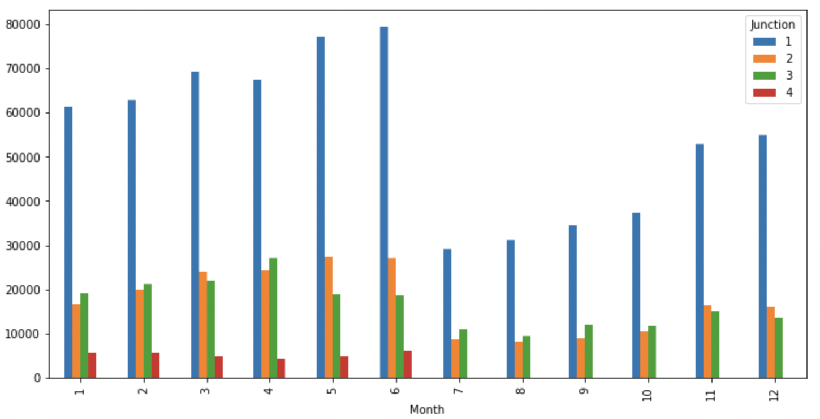
Data Visualization
comparative analysis of cumulative traffic movement over the month of the period in review
for the junctions.
Junction 4 which had recording for just the first half of the year, there seems to be rising case
of traffic across all junctions where the traffic dropped and start rising again.

Slide 11
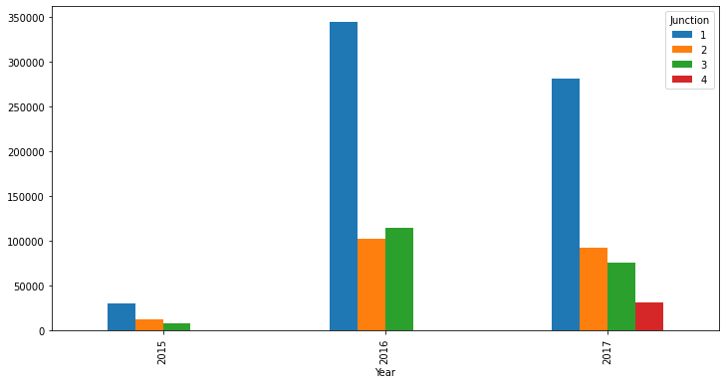
Data Visualization
Using a bar plot to compare rate of vehicular movement for
each year per junction
The Year Bar Plot showed a sharp increase in Traffic Movement for Junction 1 through 3 for 2016 as
compared to 2015 which dropped for 2017 on the addition of junction 4.

Slide 12
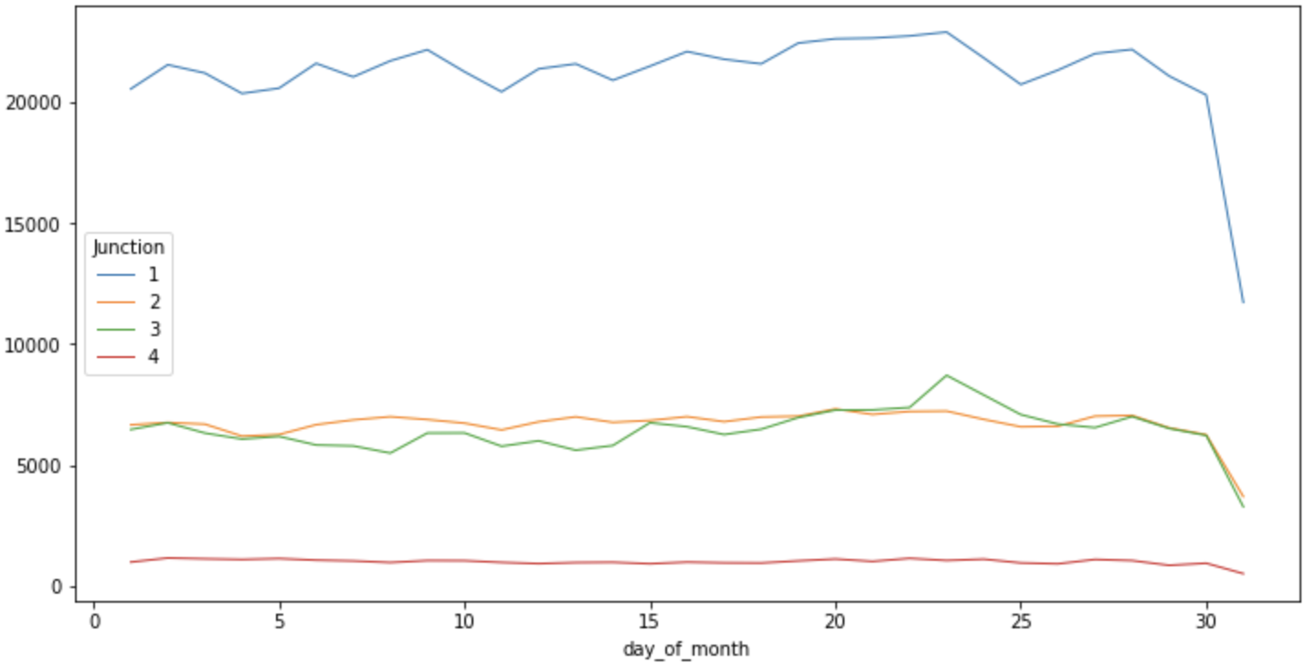
Data Visualization
Visualizing Daily Traffic situation for each junctions
The Daily Traffic Visualization potrayed a Steady flow until towards the end
of the month where there is a sharp drop for all junctions.

Slide 13
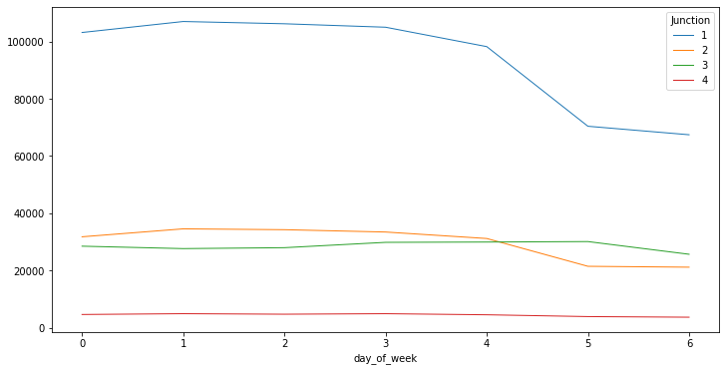
Data Visualization
Visualizing Daily Traffic situation for each junctions.
Traffic flow was observed to be steady across all junctions until Fourth day (Thursday)
where there is a sharp drop of movement till rest of the week

Slide 14
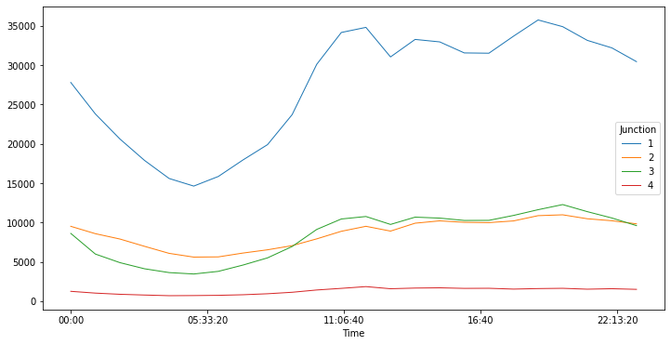
Data Visualization
Visualizing Hourly Traffic situation for each junctions.
The Hourly Analysis Shows Least Traffic situation at early period of the day, with peak traffic
experienced at the later hour of the day

Slide 15
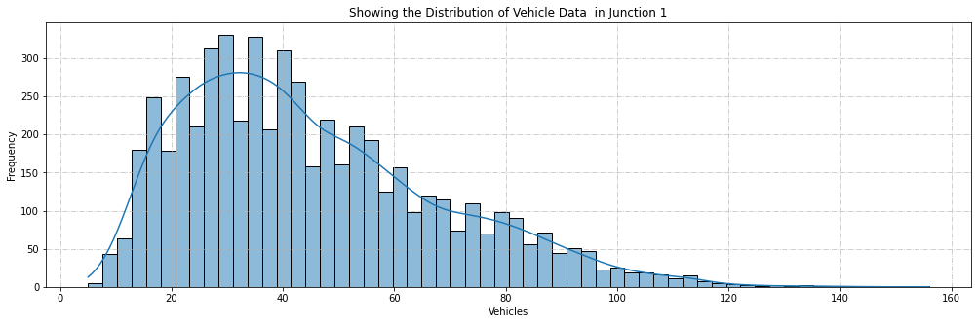
Data Visualization
Bivariate Analysis.

Slide 16
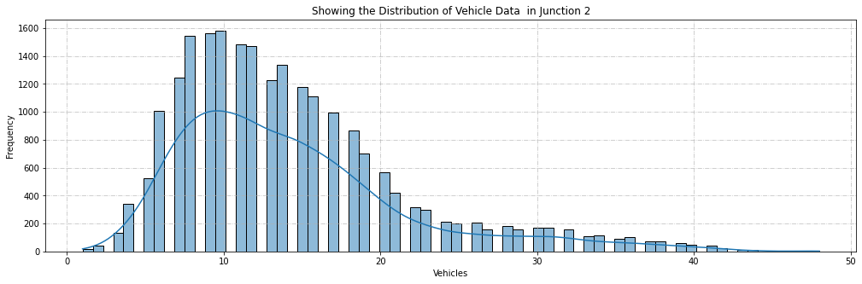
Data Visualization
Bivariate Analysis.

Slide 17
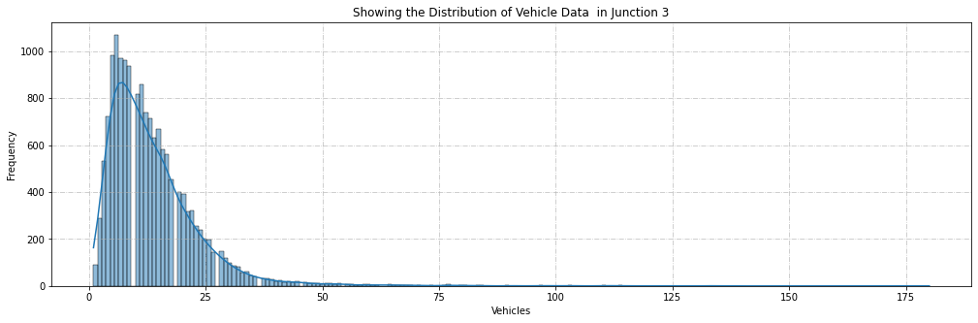
Data Visualization
Bivariate Analysis.

Slide 18
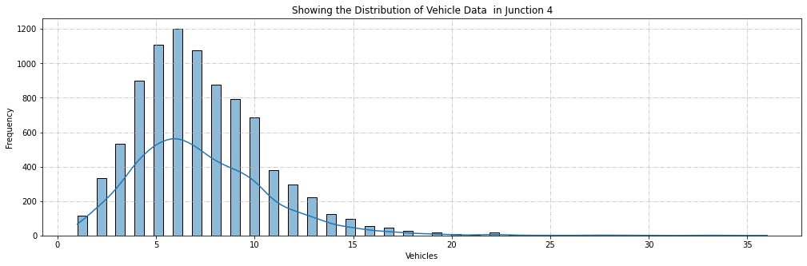
Data Visualization
Bivariate Analysis.

Slide 19
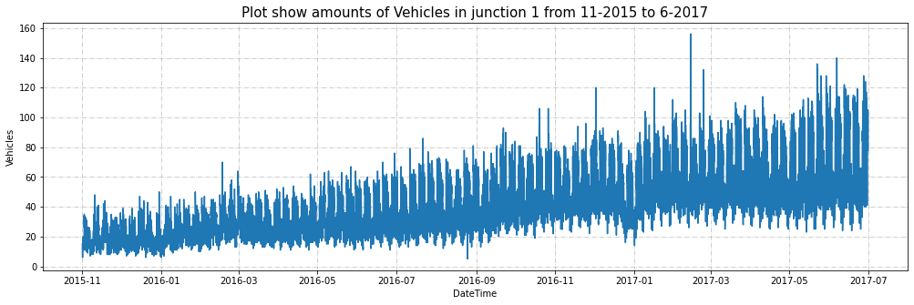
Data Visualization
Bivariate Analysis.

Slide 20
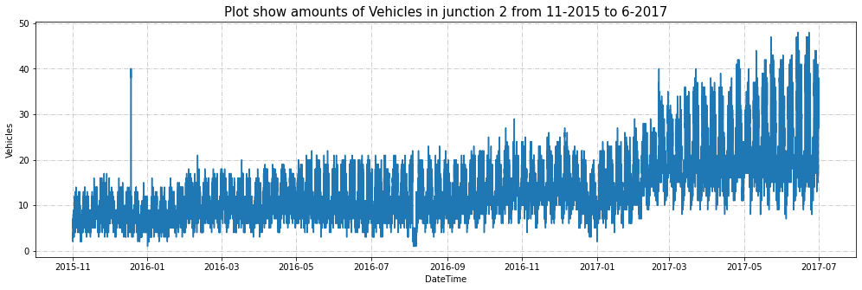
Data Visualization
Bivariate Analysis.

Slide 21
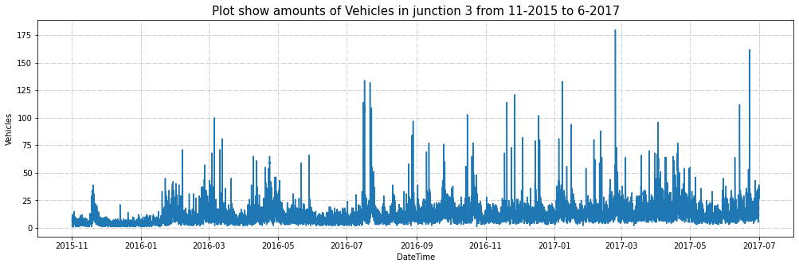
Data Visualization
Bivariate Analysis.

Slide 22
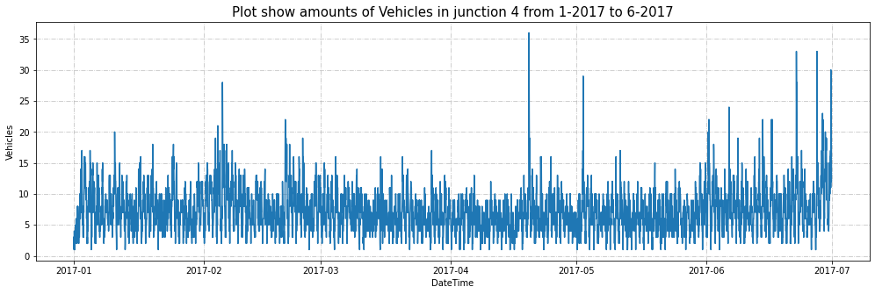
Data Visualization
Bivariate Analysis.

Slide 23
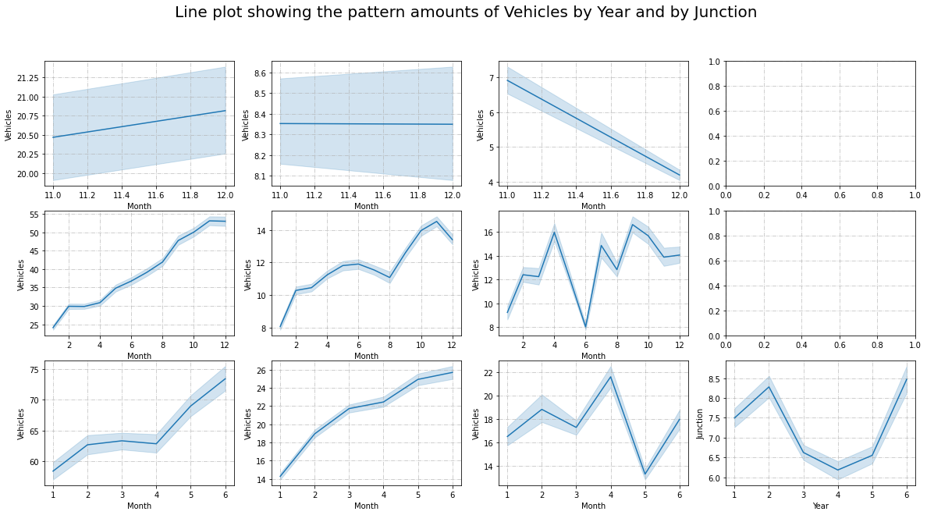
Data Visualization
Bivariate Analysis.

Slide 24
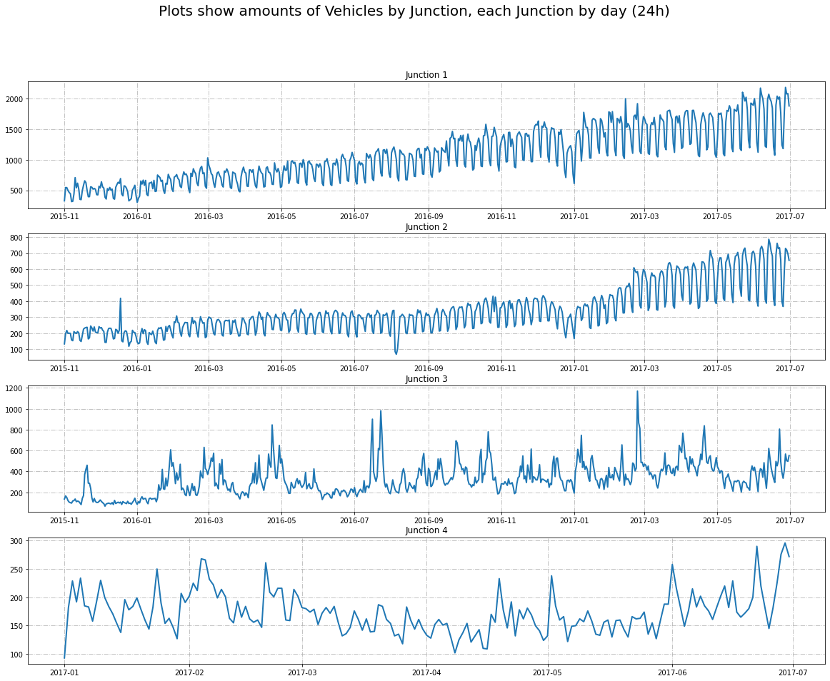
Data Visualization
Bivariate Analysis.

Slide 25
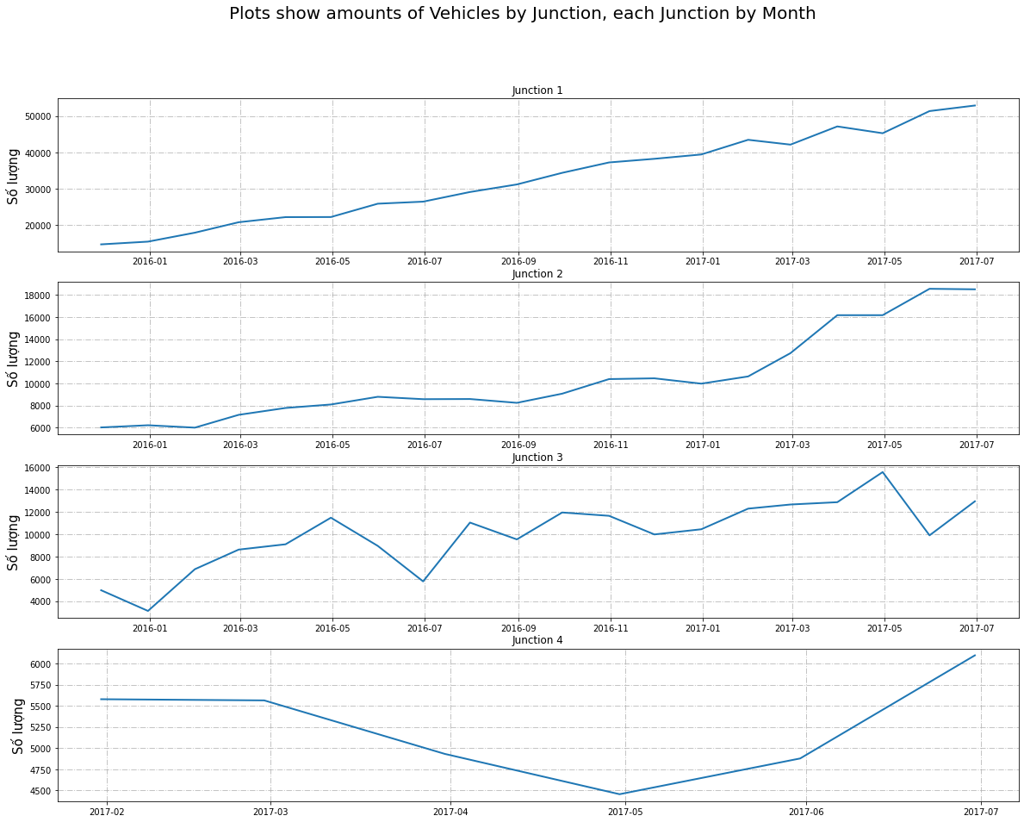
Data Visualization
Bivariate Analysis
.

Slide 26
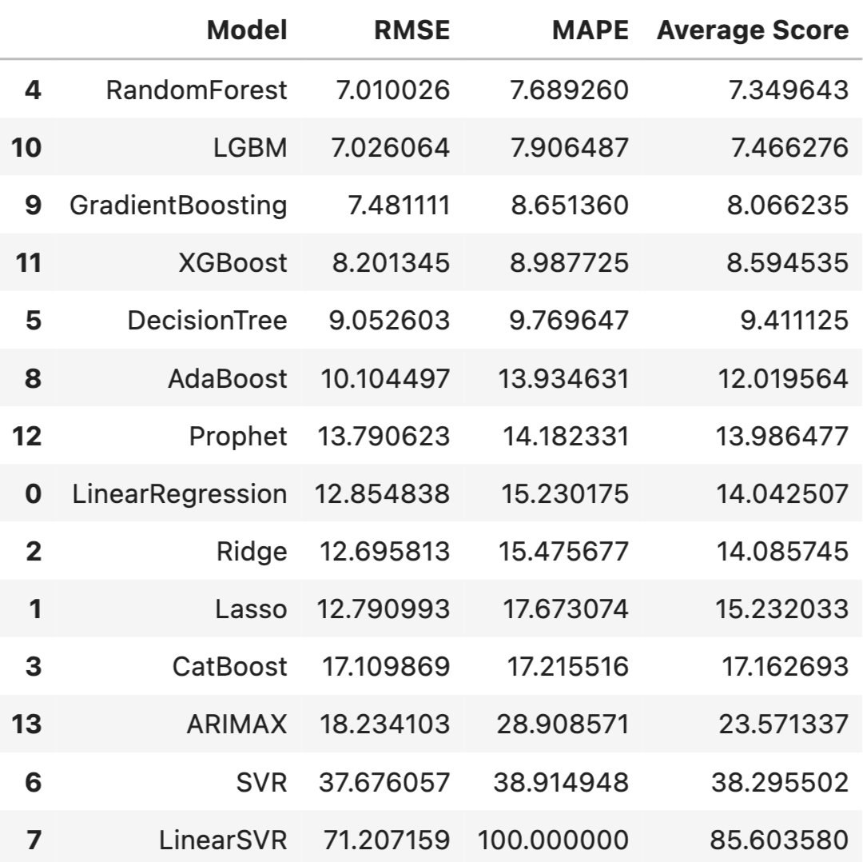
Modelling Result for junction 1
A separate model was created for each Junction. Hence for Junction 1 the model chosen was
LGBM which had RMSE is 6.2, MAPE score of 11.2, MAE score of 4.6 after cross validation

Slide 27
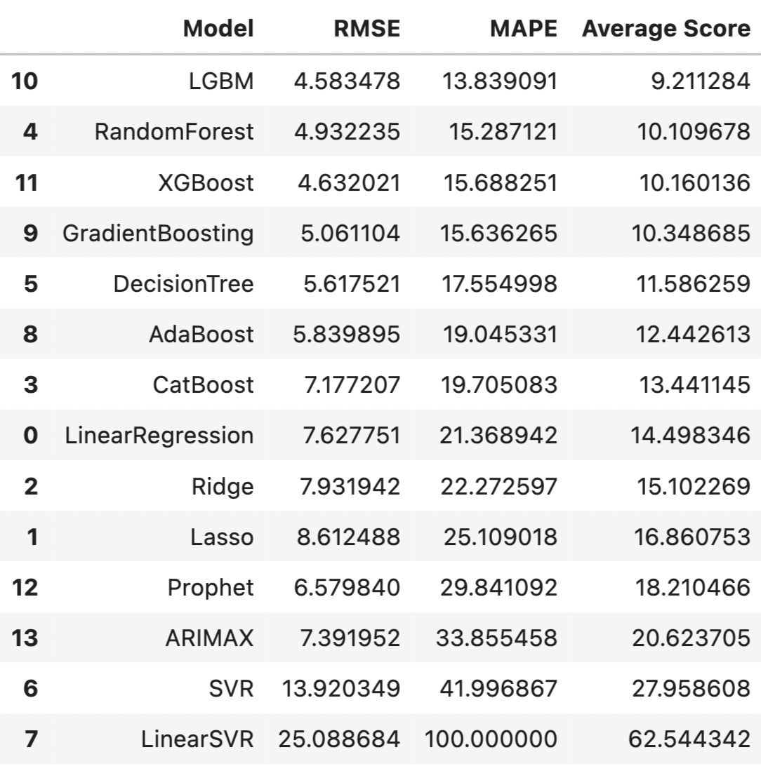
Modelling Result for junction 2
A separate model was created for each Junction. Hence for Junction 2 the model chosen was
LGBM which had RMSE is 3.28, MAPE score of 20.87, MAE score of 2.57 after cross validation

Slide 28
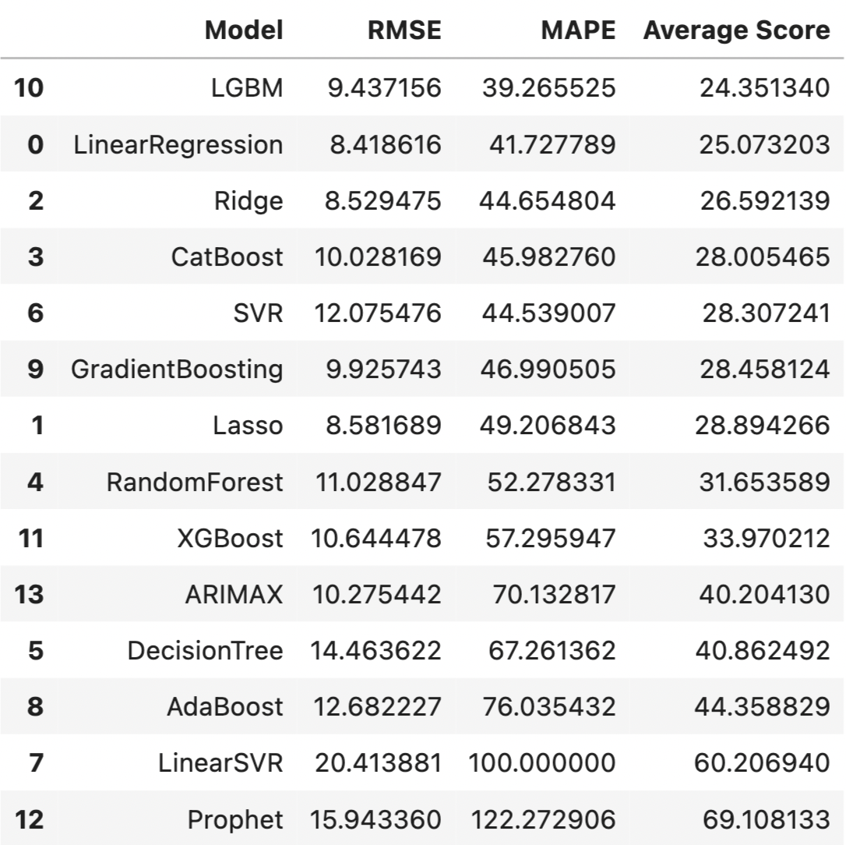
Modelling Result for junction 3
A separate model was created for each Junction. Hence for Junction 3 the model chosen was
LGBM which had RMSE is 8.82, MAPE score of 36.06, MAE score of 4.88 after cross validation

Slide 29
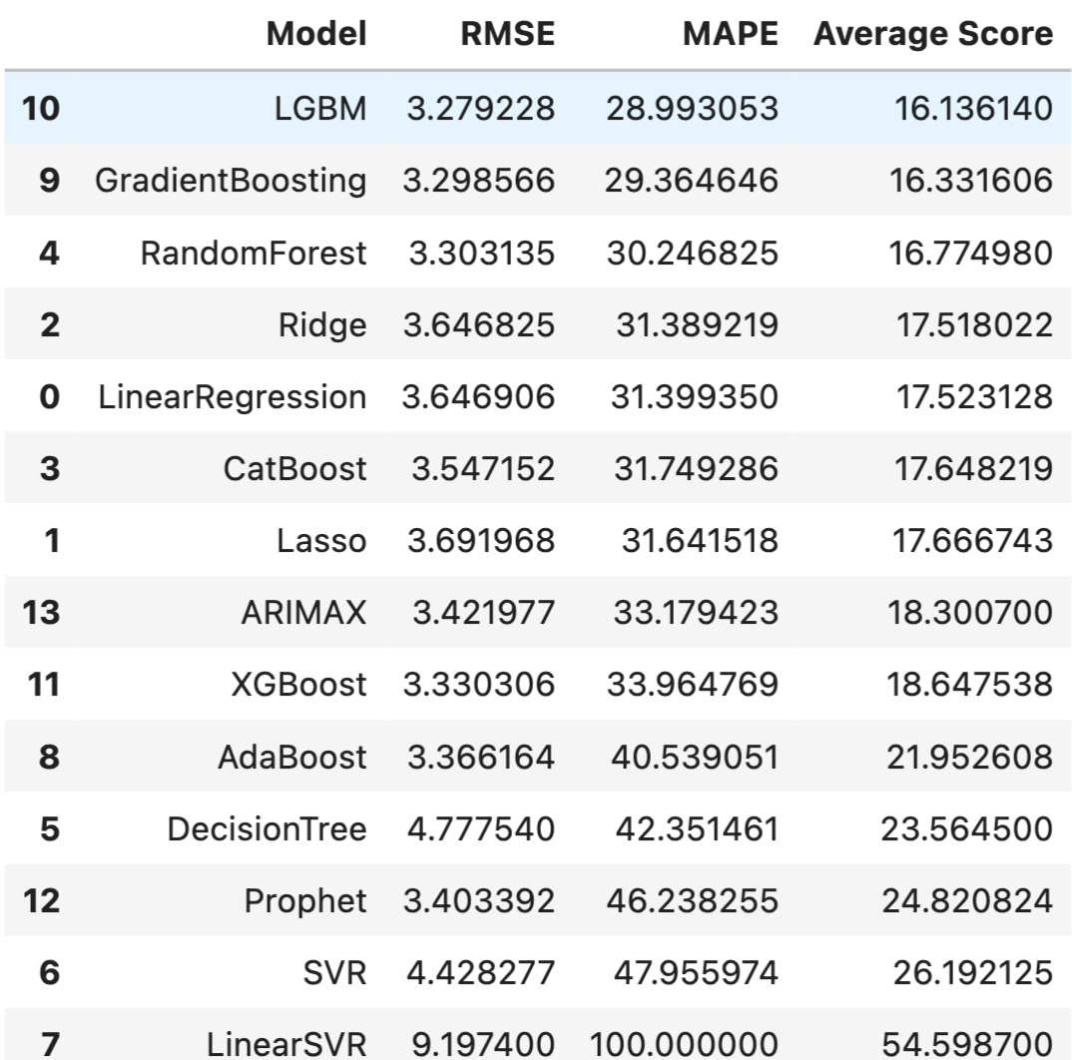
Modelling Result for junction 4
A separate model was created for each Junction. Hence for Junction 4 the model chosen was
LGBM which had RMSE is 2.79, MAPE score of 35.18, MAE score of 2.02 after cross validation

Slide 30
Summary
The insights that were gotten from the data are.
There has been upward trend of vehicles yearly in all the four junctions with junction 1
having the highest upward trend
We notice an increase in the first and third juction around the month of June, this might
be due to summer activities that happen around that time.
We notice a daily increased Vehicular movement all the junctions except junction four
which started recording data from January 2017
With the exception of junction 4, We notice the data increasing during the morning time, around 6am, stays steady throughout the afternoon, and decreases during the evening time around 8pm.
We also notice that we have less traffic during the weekend and steady traffic during the
weekdays.
Junction 4 was created to reduce the overall traffic situation on the axis which seemed to
work.
The model that was used for traffic prediction for all the four networks was LGBM

Slide 31
THANK YOU

